Slide 1
crave – to have a strong desire for (something)
The girl craves ice cream.

Slide 2
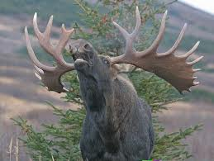
bellow - to shout in a deep voice; to make a deep loud sound
The moose will bellow if you interrupt his nap.

Slide 3
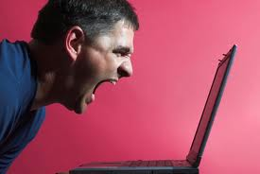
exasperate - to make (someone) very angry or annoyed
Do not exasperate your brother with endless questions.

Slide 4
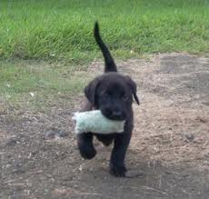
retrieve - to get and bring (something) back from a place; to find and get (information) from a computer or disk
Dogs retrieve toys.

Slide 5
vapor - a substance that is in the form of a gas or that consists of very small drops or particles mixed with the air
The hot vapor is moving out of the coffee cup.

Slide 6
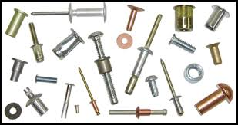
rivet - a special kind of metal bolt or pin that is used to hold pieces of metal together
The rivets in the window will need to be replaced.

Slide 7
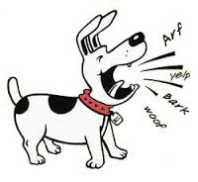
incessant - continuing without stopping; not stopping
This dog barks incessantly; he is demonstrating incessant barking.

Slide 8
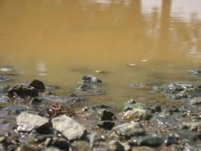
murky – very dark or foggy; not clear
You should not drink murky water.

Slide 9
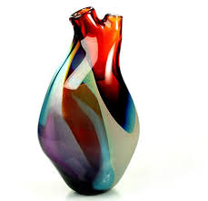
fragile – easily broken or destroyed; delicate
The vase is fragile.
My sister has a fragile personality.

Slide 10
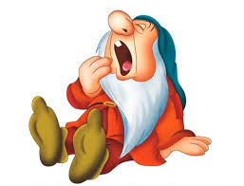
momentarily – for a short time; very soon
He was so tired he fell asleep momentarily .

